Slide 1
Santa Barbara City Community Formation Committee: Oversight Models Summary
JULY 2021

Slide 2
There are four civilian review system types
01
Review-focused
“We value the principles of participation and respect, fairness and impartiality, transparency and trust- worthiness, and understand that they apply to the work of both civilian oversight and law enforcement”
- NACOLE
02
Auditor/monitor focused
03
Investigation-focused
04
Hybrids

Slide 3
Most Common Oversight Type
Review-focused agencies represent the earliest and most common form of civilian oversight in the United States, accounting for nearly 62% of civilian oversight agencies
REVIEW
Brings Forward Community Input
AUDITOR/MONITOR
In their most basic form, review-focused agencies provide community members outside of and unaffiliated with the law enforcement agency with an opportunity to review the quality of completed misconduct complaint investigations performed by the overseen department
INVESTIGATION
Not Limited to Completed Internal Investigations
HYBRID
Can also receive civilian complaints and forward them to the department for investigation, remand cases back to the department’s internal affairs unit for further investigation, hear appeals from complainants or subject officers, recommend case dispositions, discipline, or revised policies, hold public forum, and conduct community outreach

Slide 4
Review Models Require Changes to City Administrative Functions
Replace or Duplicate IA Process
An individual or commission is authorized to review Internal Affairs (IA) investigations of complaints, find them adequate or not, and state whether it agrees or disagrees with findings
Make Recommendations
May make recommendations to police executives regarding findings or request that further investigation or trainings be conducted

Slide 5
The review model is used in multiple cities in California
Claremont
Davis
Novato
Riverside
Santa Cruz
Santa Cruz, CA

Slide 6
Focus on Policy & Trend Analysis
Examines broad patterns in misconduct investigations including patterns in the quality of investigations, findings, and discipline rendered to make proactive policy recommendations
REVIEW
Promote Systemic Change
AUDITOR/MONITOR
This model addresses systemic issues, analyzes patterns and trends, and addresses deficiencies in policies and procedures
INVESTIGATION
Wide Audit Authority
HYBRID
These models may cover any aspect of the overseen law enforcement agency such as complaints, discipline, training, staffing and recruitment, use of force, and crime prevention strategies. They can typically issue recommendations regarding any aspects of the law enforcement agency that are in their purview.

Slide 7
Auditor/Monitor Models Require Changes to City Administrative Functions
Monitor Internal Investigations
Some auditor/monitors may actively participate in or monitor open internal investigations
Review Policy & Practice
May make recommendations to police executives regarding findings or request that further investigation or trainings be conducted
Identify Trends
Can identify areas of weakness, particularly bias, by providing opportunities for dialogue and understanding between police and individuals or groups within the community
Proactive Assessment
Ability to assess the effectiveness of early warning systems and determining whether discipline is consistent and fair

Slide 8
The investigation model is used in multiple cities in California
Berkeley
Long Beach
San Francisco
Berkeley, CA

Slide 9
Investigative Authority
Investigative models employ professionally trained staff to independently investigate misconduct allegations of the overseen department’s internal affairs unit or replace critical functions of a standard internal affairs unit
INVESTIGATION
More Access Than Other Models
AUDITOR/MONITOR
Investigation-focused agencies have greater access to law enforcement records and databases than review-focused agencies, particularly with body-worn camera and in-car video footage. They are more likely to have the ability to subpoena documents and witnesses than other models to expedite the collection of evidence.
INVESTIGATION
HYBRID
Commonly Include Volunteer Board
These can vary greatly. In some cases, the board or commission acts in an advisory capacity or a leadership capacity. Some may conduct votes to initiate investigations, issue subpoenas, and determine the dispositions of misconduct allegations based on staff investigations.

Slide 10
Investigation Models Require Changes to City Administrative Functions
Replace or Duplicate IA Process
May replace or duplicate the police internal affairs process
Findings & Recommendations
Can make recommendations or findings as to whether the evidence supports the allegations; in some oversight system, the agency has the authority to recommend and/or impose discipline
Independent Investigation
Not necessary (or even advantageous) that the investigators be formally trained law enforcement officers

Slide 11
The auditor/monitor model is used in multiple cities in California
San Jose
Anaheim
Fresno
Inglewood
Sacramento
Sacramento, CA

Slide 12
Go Beyond Traditional Models
Often the best choice for a custom fit, these models combine the functions of the other model types
REVIEW
Hybrid Agencies (1 oversight body)
An agency may primarily focus on one oversight function while also performing other functions under one roof (such as reviewing internal investigations and auditing policy compliance)
AUDITOR/MONITOR
INVESTIGATION
Hybrid Systems (multiple oversight bodies)
A single jurisdiction may have multiple agencies overseeing the same department, such as an independent investigative agency and an inspector general, or a monitor agency and a civilian board acting in an advisory capacity to the law enforcement agency and/or other civilian oversight agency
HYBRID

Slide 13
Hybrid Models Require Changes to City Administrative Functions
Choose Your Adventure
Ultimately, administrative changes are dependent on the combination of models of oversight and authority given to the hybrid agency or system
Agency
System

Slide 14
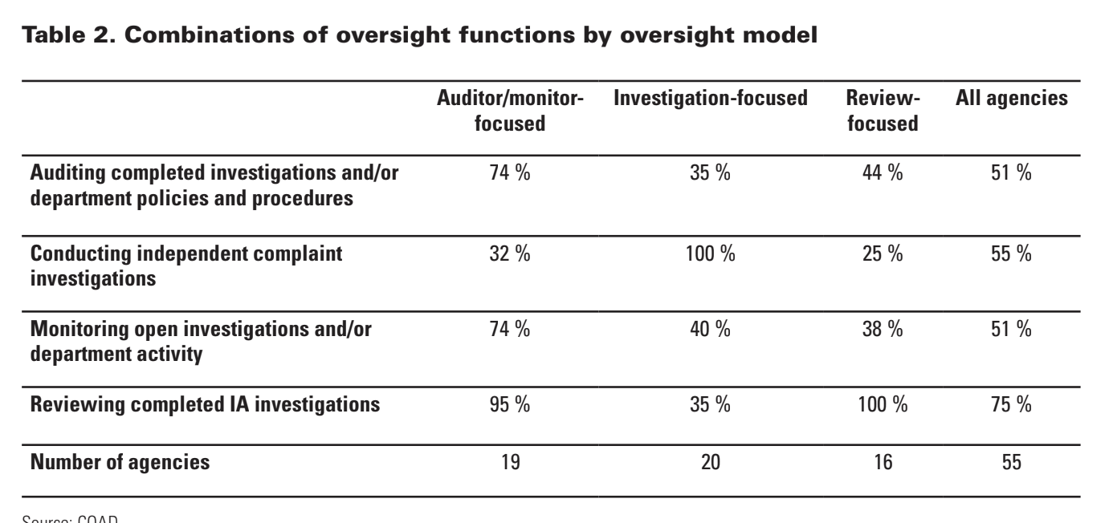
Source: Civilian Oversight Agency Directory (COAD)

Slide 15
The investigation model is used in multiple cities in California
Los Angeles
Oakland
San Diego
Los Angeles, CA

Slide 16
Model Type | Cost | Complexity
Review-focused Community review and comment on completed investigations | $-$$ | 🧩🧩
Investigation-focused Trained staff independently conducts misconduct investigations | $$$$ | 🧩🧩🧩🧩
Auditor/monitor-focused Policy & trend analysis for systemic recommendations | $$-$$$ | 🧩🧩🧩
Hybrid Combined functions of multiple models; either hybrid agency or hybrid system | $-$$$$ | 🧩🧩🧩🧩🧩

Slide 17
directory.nacole.org
Civilian Oversight Agency Directory (COAD) Database

Slide 18
Overall Estimates
Review-focused | Investigation-focused | Auditor/monitor-focused
Median Cost $524,000 | Median Cost $496,000 | Median Cost $329,000

Slide 19
All Municipal Cost Overview*
*All oversight agencies in COAD database that oversee a municipal police department
 | REVIEW FOCUSED | INVESTIGATION FOCUSED | AUDITOR/MONITOR FOCUSED
AVERAGE COST | $525,000 | $2,300,000 | $526,000
MEDIAN COST | $186,000 | $722,000 | $300,000

Slide 20
Only Municipal Cost Overview*
*Only oversight agencies in COAD database that oversee a municipal police department
 | REVIEW FOCUSED | INVESTIGATION FOCUSED | AUDITOR/MONITOR FOCUSED
AVERAGE COST | $525,000 | $3,000,000 | $747,000
MEDIAN COST | $266,000 | $938,000 | $319,000

Slide 21
Only Municipal w/ Population Cost Overview*
*Only oversight agencies in COAD database that oversee a municipal police department and serve a population of fewer than 150,000 people
 | REVIEW FOCUSED | INVESTIGATION FOCUSED | AUDITOR/MONITOR FOCUSED
AVERAGE COST | $110,000 | $444,000 | $250,000
MEDIAN COST | $82,000 | $553,000 | $268,000

Slide 22
Oversight Cost Estimates
An overview of average costs from the Civilian Oversight Agency Directory (COAD) Database

Slide 23
Thanks!

